Slide 1
Centre Academy London
Options evening

Slide 2
Curriculum
Core Subjects:
English
Maths
Science
PE
PSHE
Other lessons/sessions:
SALT
Careers/LS
OT
Literacy/numeracy
ELSA
ICT
Religious Studies
Art
Drama
Humanities
Creative Media

Slide 3
curriculum for end of ks3-4

Slide 4
Curriculum ks4
Core Subjects:
English
Maths
Science
PE
PSHE
Other lessons/sessions:
SALT
Careers
OT
Literacy/numeracy
Citizenship
+2 option subjects

Slide 5
Curriculum ks4
Functional Skills Pathway
CGSE Pathway
Hybrid Pathway
'Traditional'
'Accessible'
'Combination'

Slide 6
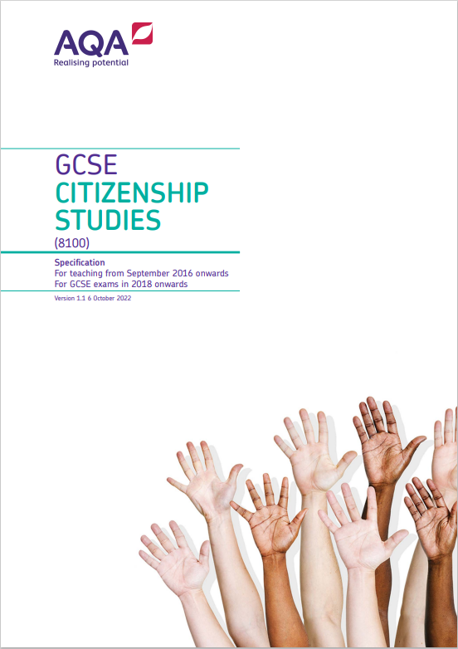
SUBJECT: Citizenship
Exam board: AQA
Qualification type: GCSE
Details of course: Exam based
Paper 1: Section A: Active citizenship Section B: Politics and participation
Written examination: 1 hour 45 minutes - 50% of GCSE - 80 marks
Paper 2: Section A: Life in modern Britain Section B: Rights and responsibilities
Written examination: 1 hour 45 minutes - 50% of GCSE - 80 marks
AQA | Citizenship Studies | GCSE | GCSE Citizenship Studies

Slide 7
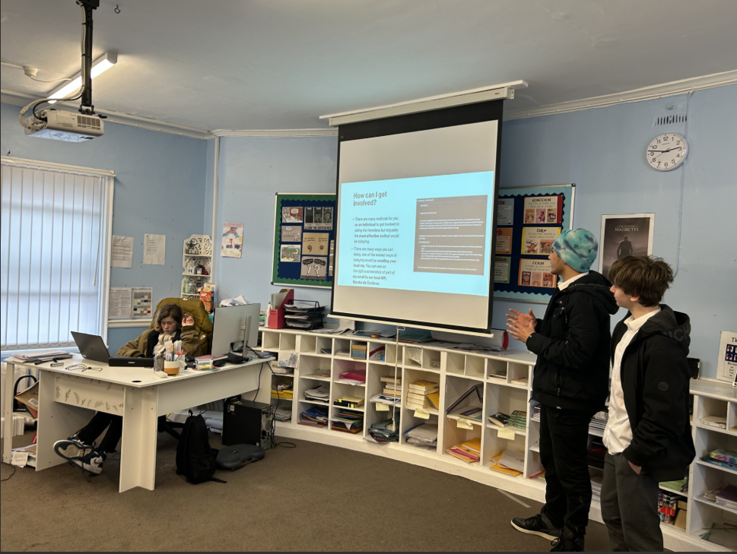
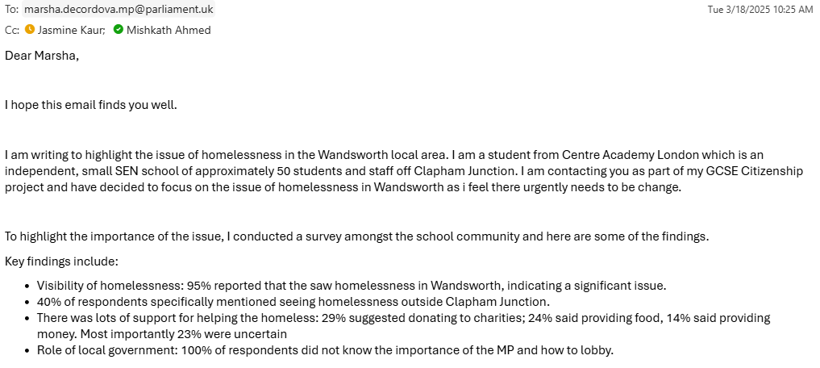
SUBJECT: Citizenship
Content covered:
Paper 1, Section A: Students are required to undertake an investigation into a citizenship issue of their own choice which involves research, action and reflection.
Paper 1, Section B: Students will look at the nature of political power in the UK and the core concepts relating to democracy and government. This includes how government operates at its various levels within the UK, how decisions are made and how the UK parliament works and carries out its functions. It also looks at the role of political parties, the election system, how other countries govern themselves and how the citizen can bring about political change
Paper 2, Section A: In this theme students will look at the make-up, values and dynamics of contemporary UK society. They will consider what it means to be British, how our identities are formed and how we have multiple identities. Students will also look at the role and responsibilities of the traditional media, the impact of new media formats and the UK's role in international issues.
Paper 2, Section B: In this theme students will look at the nature of laws and the principles upon which laws are based, how the citizen engages with legal processes, how the justice system operates in the UK, how laws have developed over time and how society deals with criminality. Students will consider also how rights are protected, the nature of universal human rights and how the UK participates in international treaties and agreements.
Career/Further education Opportunities: Citizenship is a compulsory subject because it equips students with the knowledge and skills needed to become informed, active, and responsible members of society. It teaches young people about democracy, law, human rights, and how government works thus helping them navigate the world around them . The subject develops research, writing and teamwork skills that are highly important in school and beyond. Studying Citizenship also opens up a range of career opportunities in areas such as law, politics, public services, education, journalism, and social work.

Slide 8
SUBJECT: BTEC Sports
Exam board: Edexcel
Qualification type: BTEC
Details of course: Introductory Level 1, Level 1, Level 2
Content covered: Training for Personal Fitness, Practical Sports Performance, The Sports Industry (roles and careers), Health and Fitness (anatomy, physiology, nutrition), Leadership in Sport and Sports Psychology (motivation, confidence and mindset)
Career: Entry Level roles – Leisure centre assistant, Gym/Fitness assistant, Sports retail assistant, Junior coaching roles (under appropriate supervision) and Sports camp assistant
Further education opportunities: Level 3 National Diploma, Extended Diploma in Sport, A Level in Physical education or Biology, Enrol in other vocational courses like Sports Coaching, Fitness Instruction, or Public Services and Apprenticeships in Sports Coaching, Personal Training, Leisure Operations and Outdoor Activities Instructions

Slide 9
SUBJECT: ict
Exam board: OCR, Pearson EdExcel.
Qualification type: Functional Skills, GCSE.
Details of course: Entry Level 3, Level 1, Level 2, Level 3
Content covered: Digital Functional Skills, IT in the digital world, Data Manipulation using spreadsheets, Using Augmented Reality to present information.
Career: Software Developer / Engineer, IT Support Specialist, Cybersecurity Analyst, Digital Marketer, Web Developer, , UX/UI Designer, Data Analyst, Market Research Analyst, Financial Analyst, AR/VR Developer, Multimedia Designer, Game Developer
Further education Opportunities: Bachelor’s Degree in Information Technology, Computer Science, Cybersecurity, Data Science, Economics, or Business Analytics.
Certifications: CompTIA A+, Google IT Support, Cisco CCNA, Microsoft Excel Expert, Google Data Analytics Certificate, Tableau, Power BI, Unity Certified Developer, Google UIUX Designer.

Slide 10
SUBJECT: ict (pearson edexcel dfs)
Qualification summary:
Qualification type: Functional Skills Qualification title: Pearson Edexcel Digital Functional Skills qualification at Entry Level 3 Level: Entry 3 Accreditation status: Accredited Guided Learning Hours (GLH): 55 Total Qualification Time (TQT): 60 Qualification number (QN): 610/3359/5

Slide 11
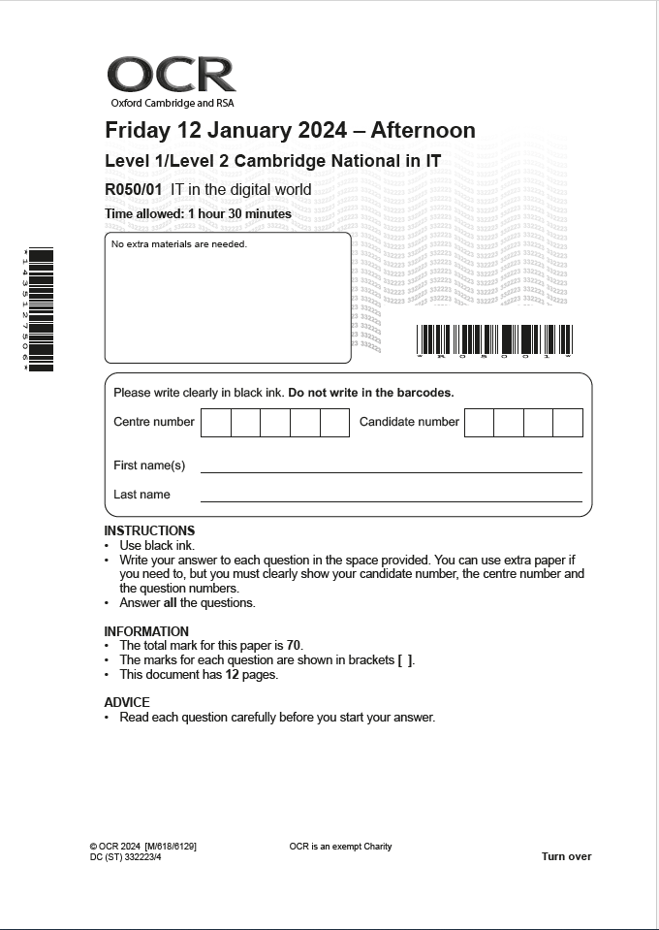
SUBJECT: ict (CAMBRIDGE NATIONALS IN IT)
Cambridge National in IT will inspire and equip students with the confidence to use skills that are relevant to the IT sector and more widely. It covers the use of IT in the digital world, Internet of Everything, data manipulation, human-computer interface (HCI) and augmented reality.
Specification code: J836

Slide 12
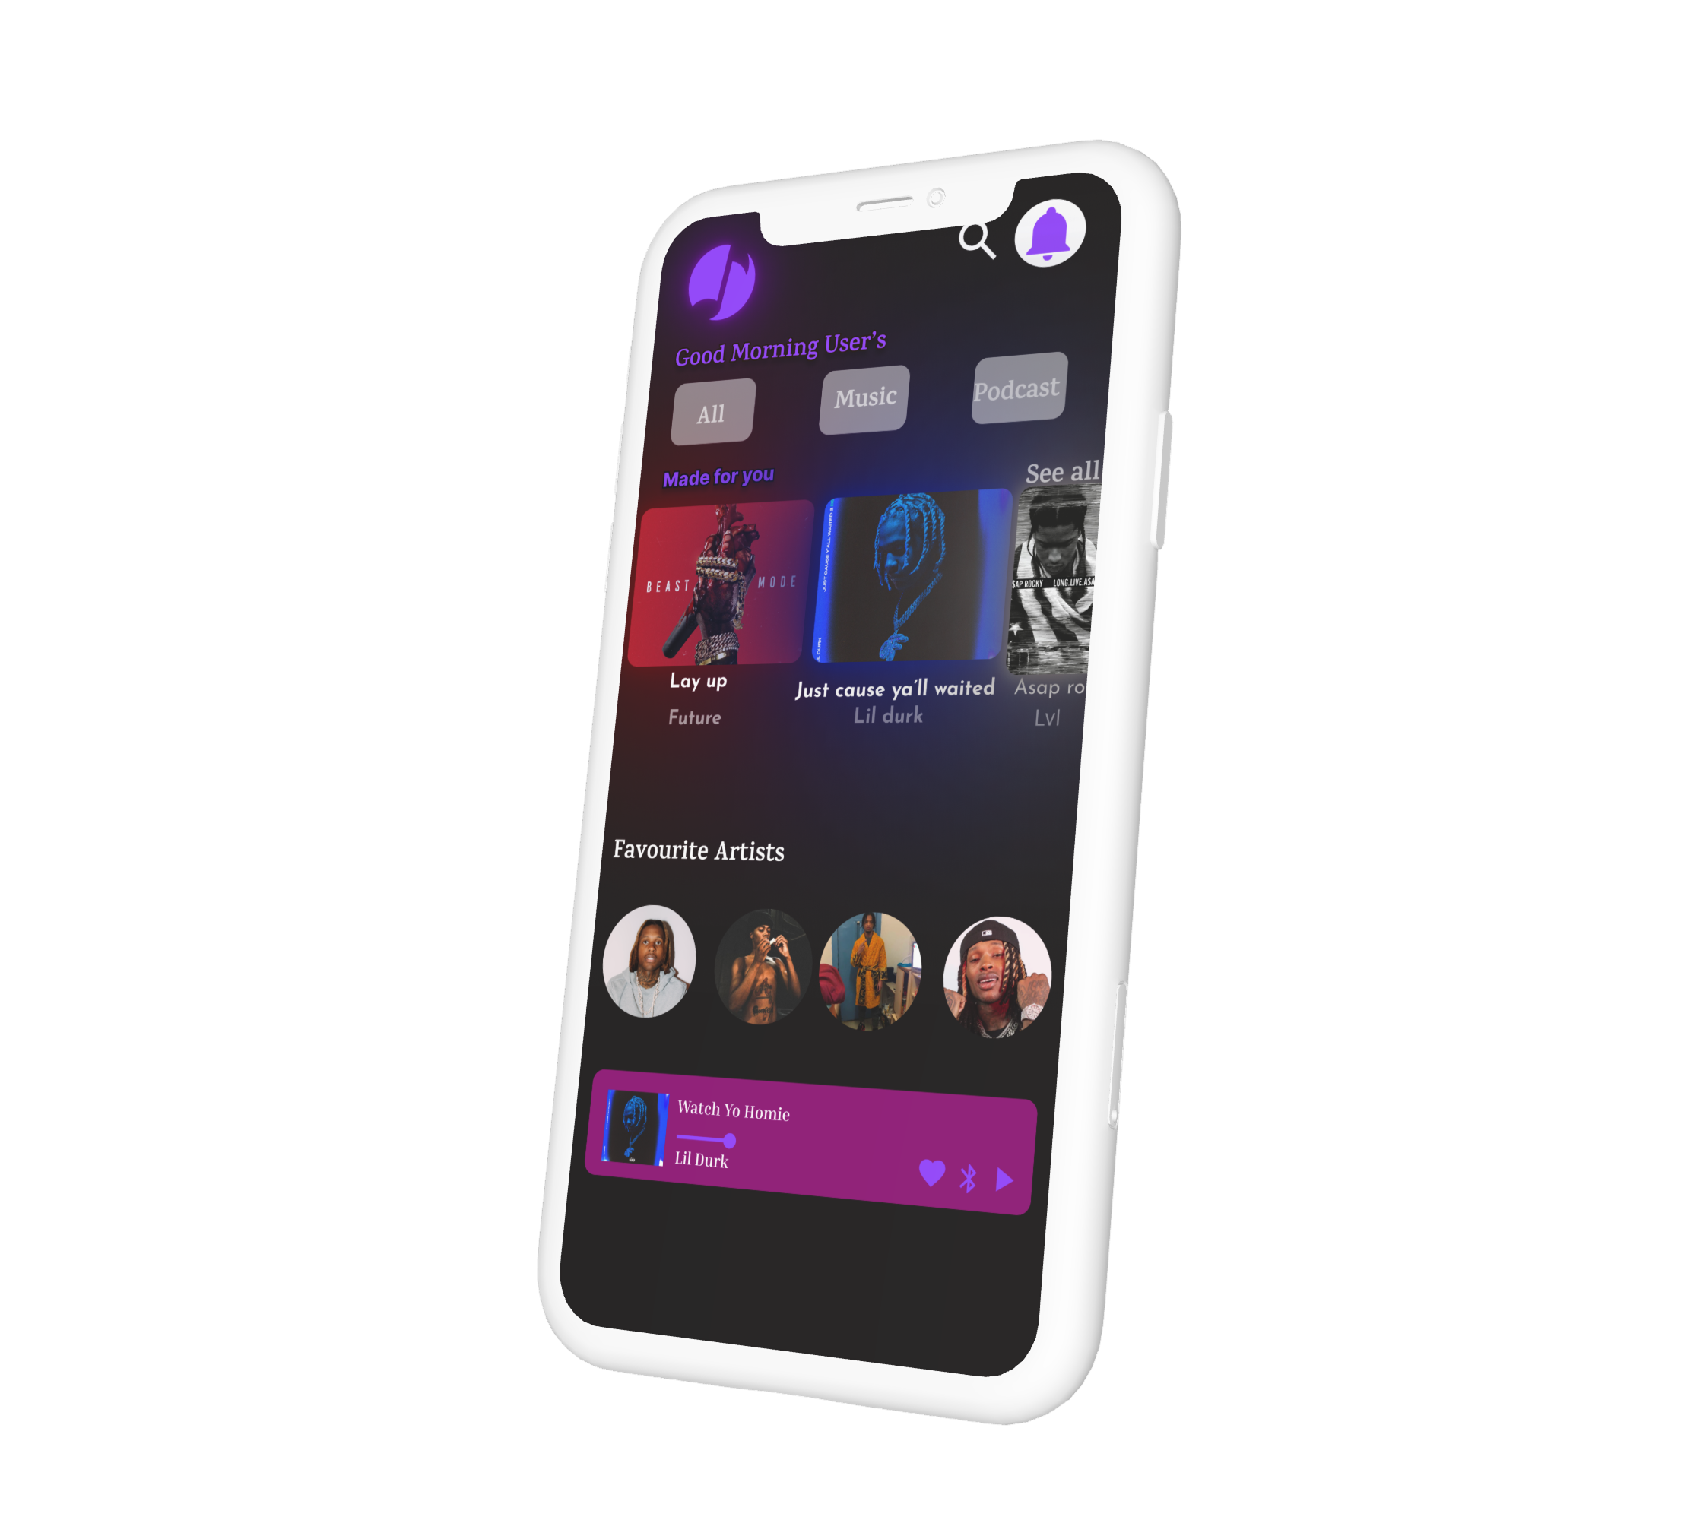
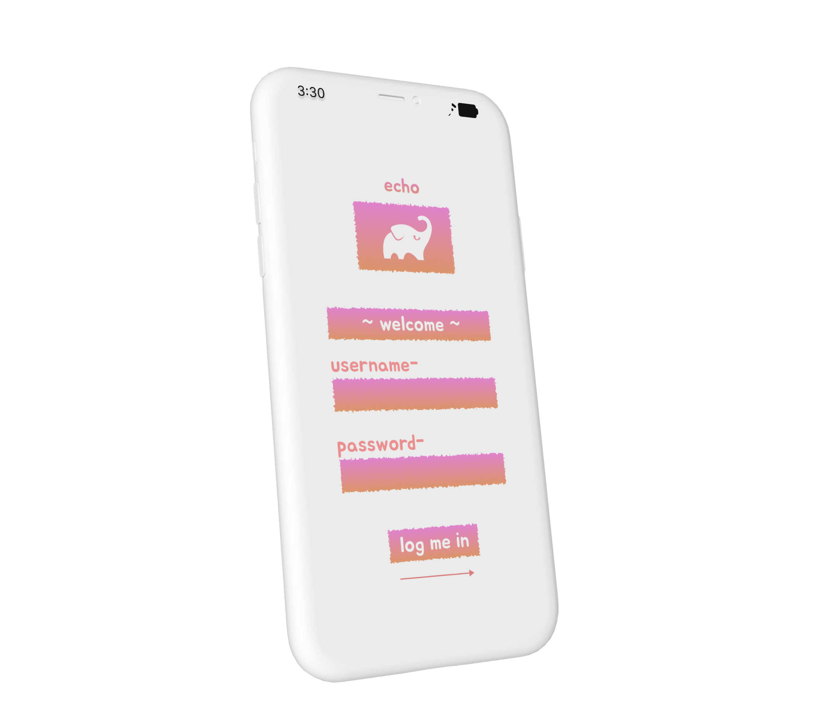
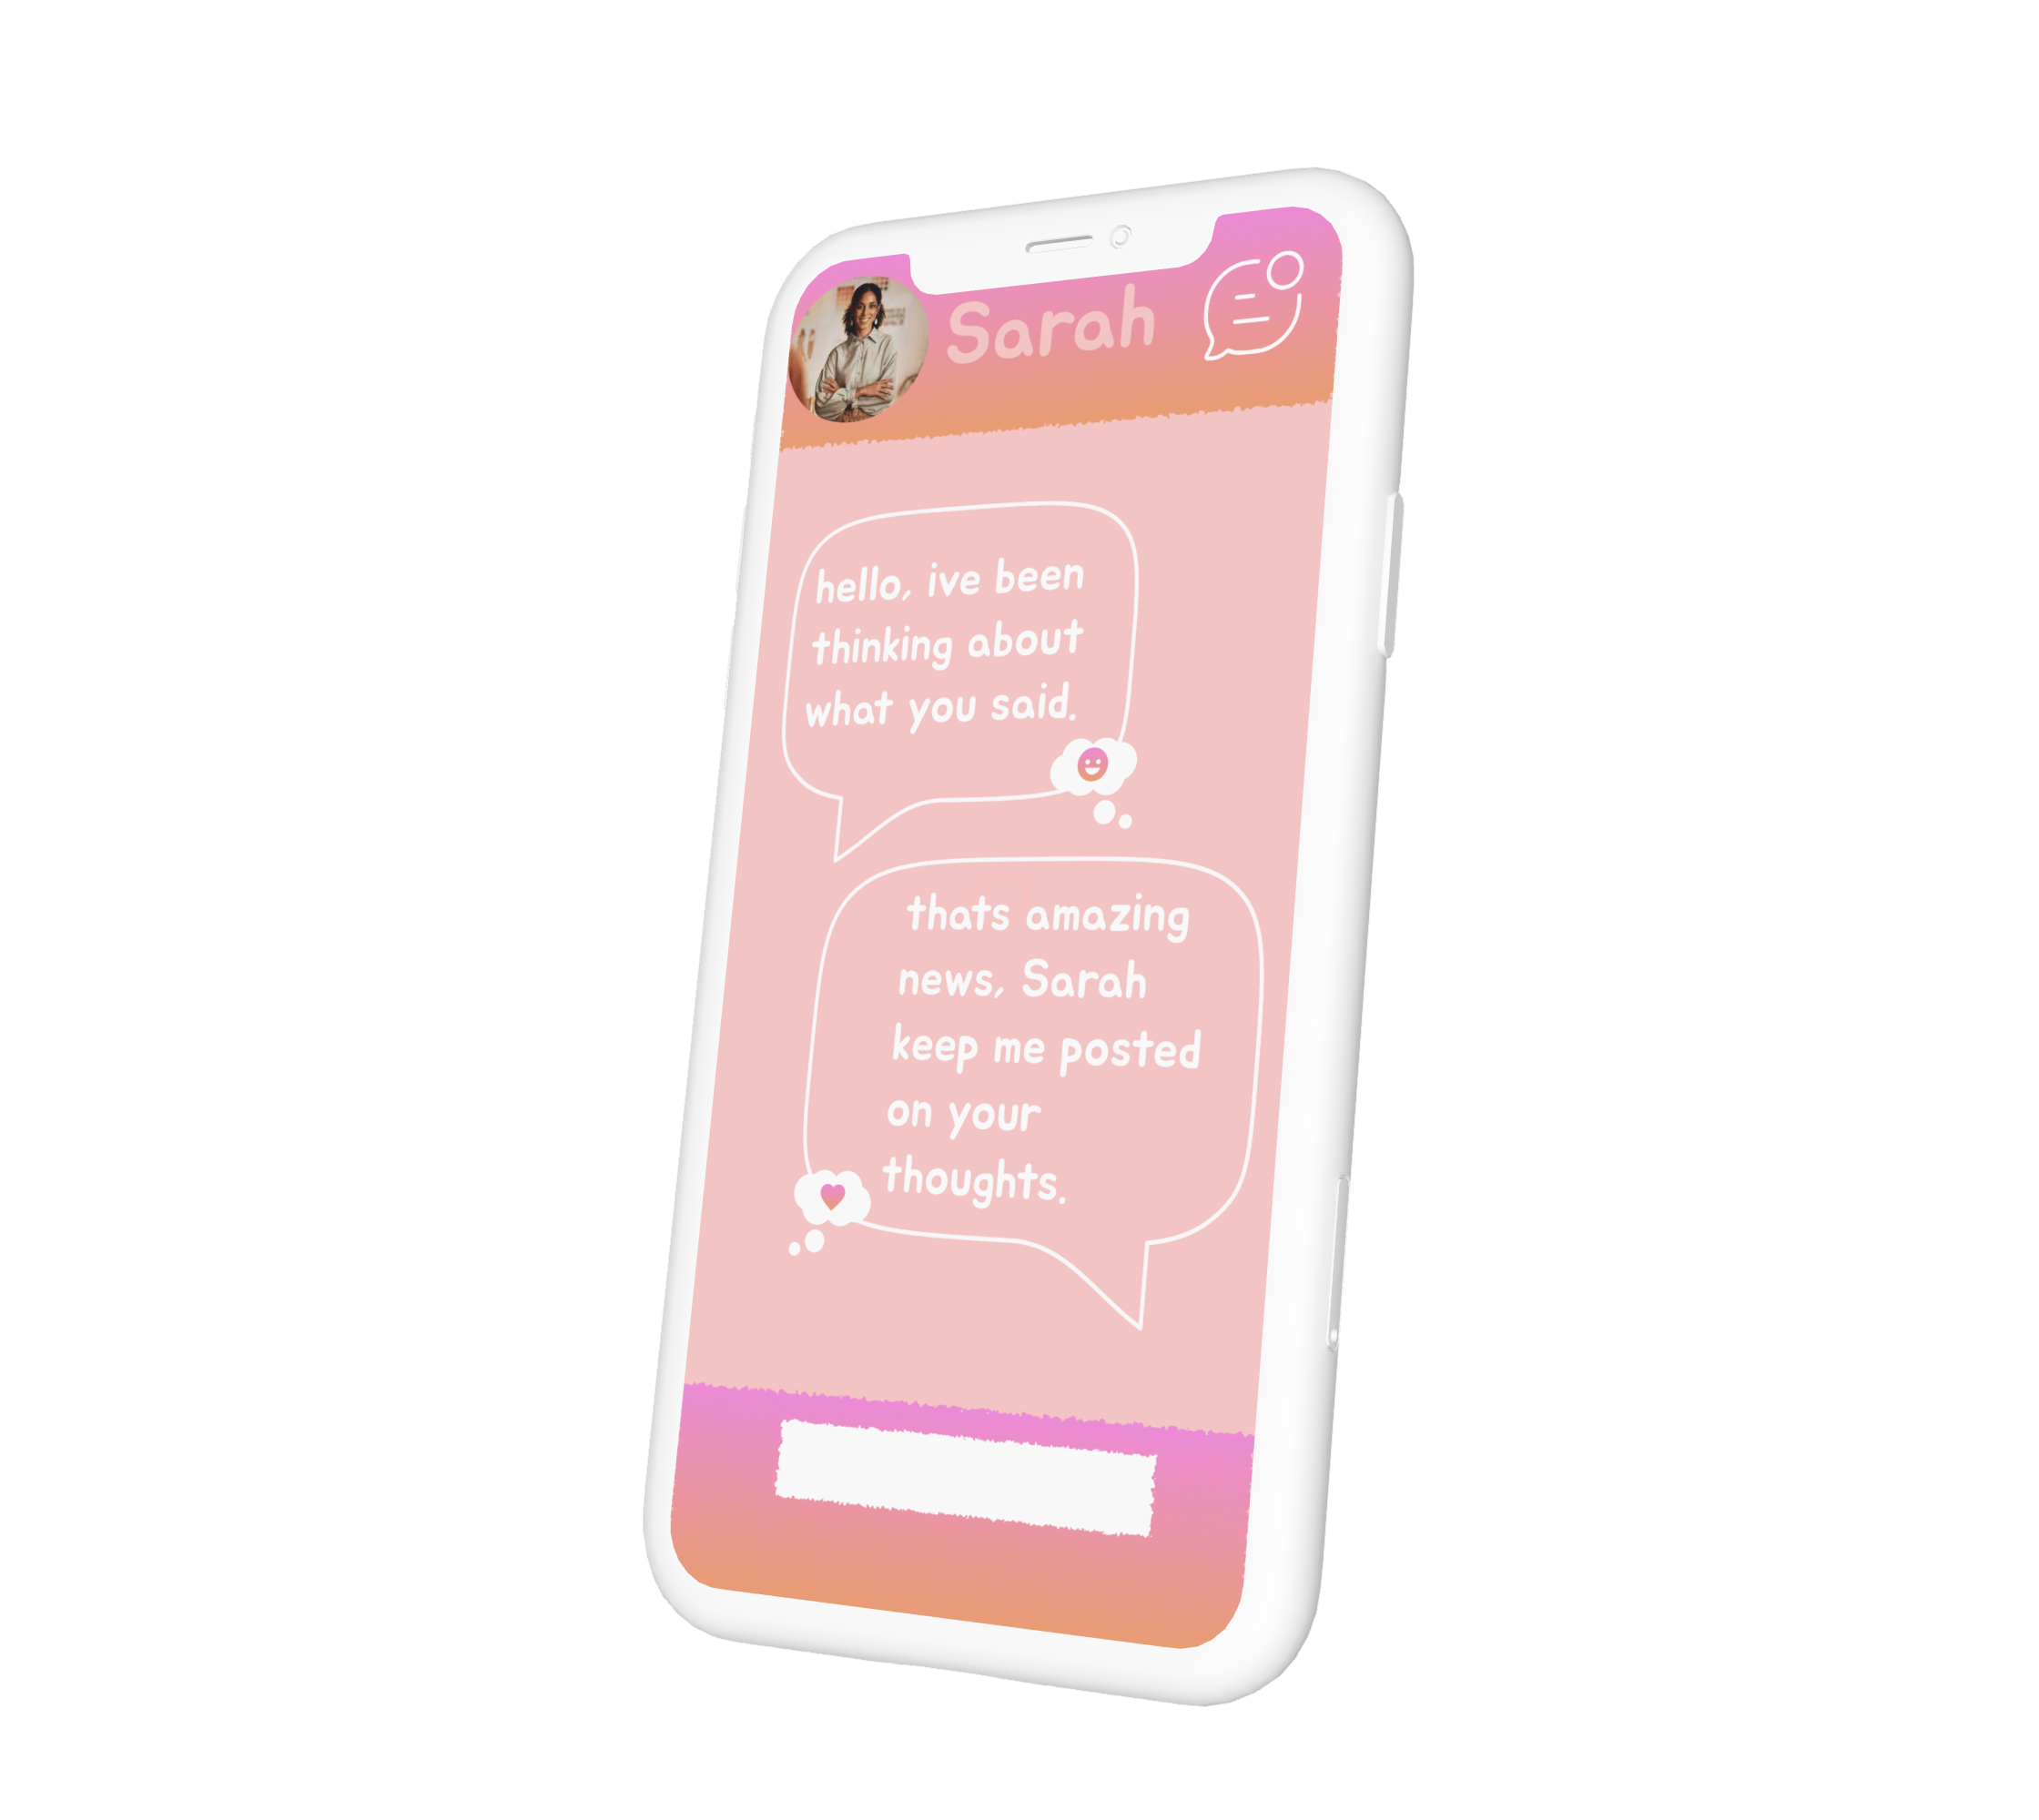
SUBJECT: ict (MOBILE APP UI/UX design by our students)

Slide 13
SUBJECT: ART
Exam board: University of the Arts London (UAL)
Qualification type: Dependent on age, level and amount of hours available, there are Level 1; L2 (GCSE equivalent) & L3 (A-level equivalent)
Details of course: 📚 Modular Assessment: Completion of a series of projects throughout the course 🎯 Final Project: A major piece externally moderated at the end of the chosen course – this can range from 4 to 9 modules. There is no timed exam.
Content covered: A Journey of Creative Development-
Developing critical thinking, research, presentation skills whilst exploring a variety of creative mediums for 2D & 3D outcomes
Career/Further education Opportunities: Careers in the Creative Industry could include Graphic Designer - Animator / Game Designer - Fashion or Interior Designer - Illustrator or Fine Artist - Architect or Product Designer - Art Therapist or Educator

Slide 14
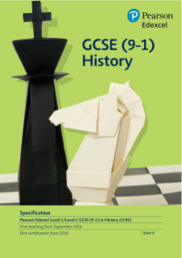
SUBJECT: History
Exam board: Pearson Edexcel
Qualification type: GCSE
Details of course: Exam based
Paper 1: Thematic study and historic environment
Written examination: 1 hour and 20 minutes - 30% of the qualification - 52 marks (16 for the historic environment, 36 for the thematic study)
Paper 2: Period study and British depth study
Written examination: 1 hour and 50 minutes - 40% of the qualification - 64 marks (32 for the period study and 32 for the British depth study)
Paper 3: Modern depth study
Written examination: 1 hour and 30 minutes - 30% of the qualification - 52 marks
https://qualifications.pearson.com/en/qualifications/edexcel-gcses/history-2016.coursematerials.html

Slide 15
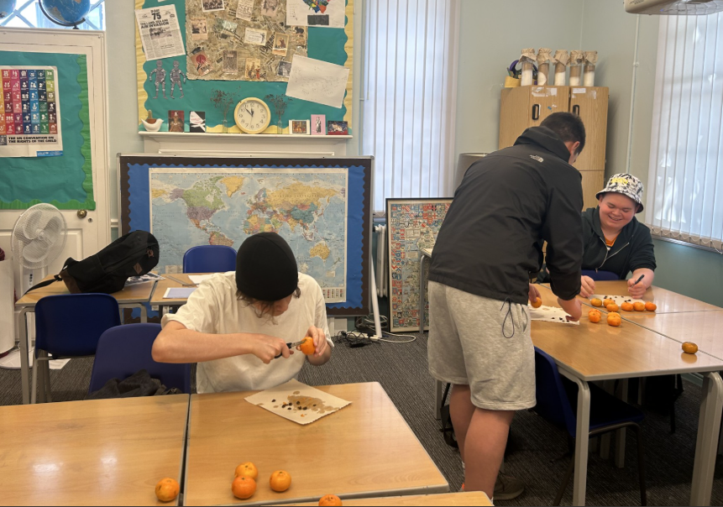
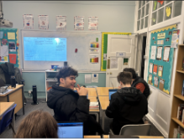
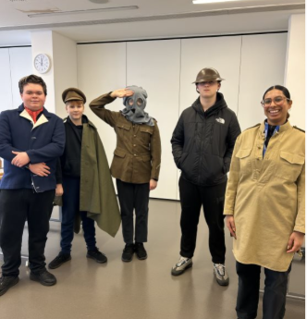
SUBJECT: History
Content covered:
Paper 1, Option 11: Medicine in Britain, c1250–present and The British sector of the Western Front, 1914–18: injuries, treatment and the trenches.
Paper 2, Option B3: Henry VIII and his ministers, 1509–40 and Option P3: The American West, c1835–c1895
Paper 3: Option 31: Weimar and Nazi Germany, 1918–39
Career/Further education Opportunities: Taking GCSE History helps develop critical thinking and analytical skills by encouraging learners to evaluate sources; identify bias; and understand different perspectives. Studying history also enhances research and essay-writing skills, which are useful in many other subjects. Additionally, it provides a deeper understanding of the world; helps students foster empathy; and encourage curiosity – in sum creating students who leave school with the right tools for their future pathways. A qualification in History can lead to a variety of career paths, including roles in law, journalism, education, politics, museum work, and public relations.

Slide 16
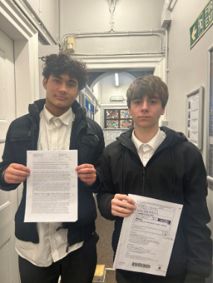
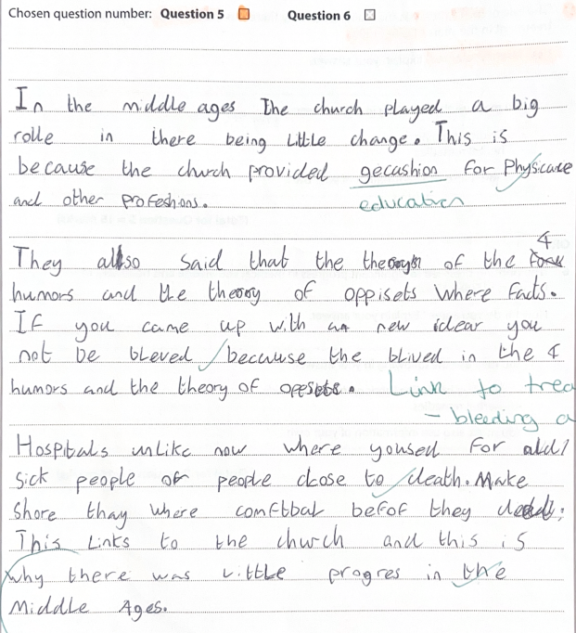
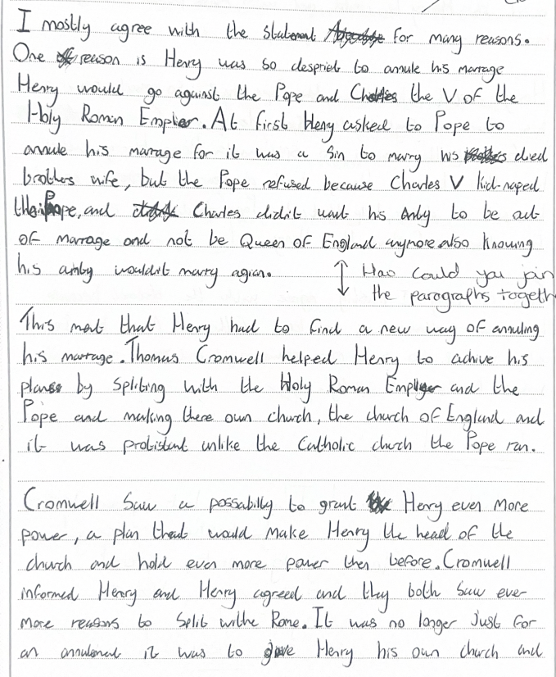
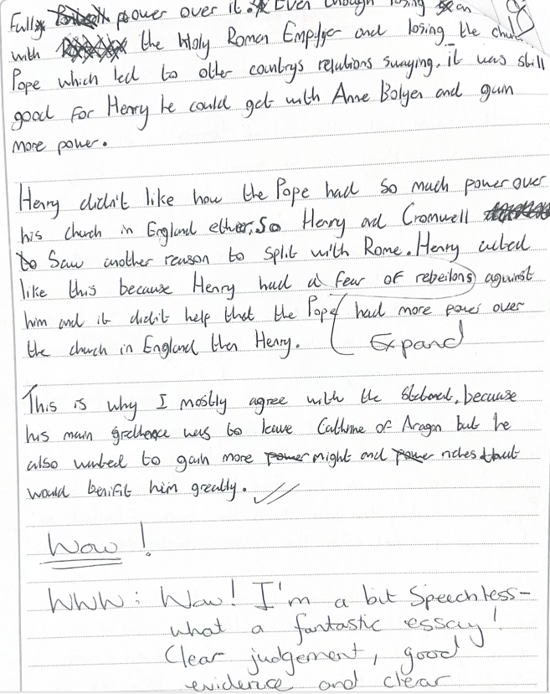
SUBJECT: History
My college needs me to pass History to go on to do Classics and then I can get into University.
Why wouldn't you want to learn about History – it should be compulsory!
In short History is all about enriched, student focused learning where students are supported to achieve and understand better the world around them!
One year later

Slide 17
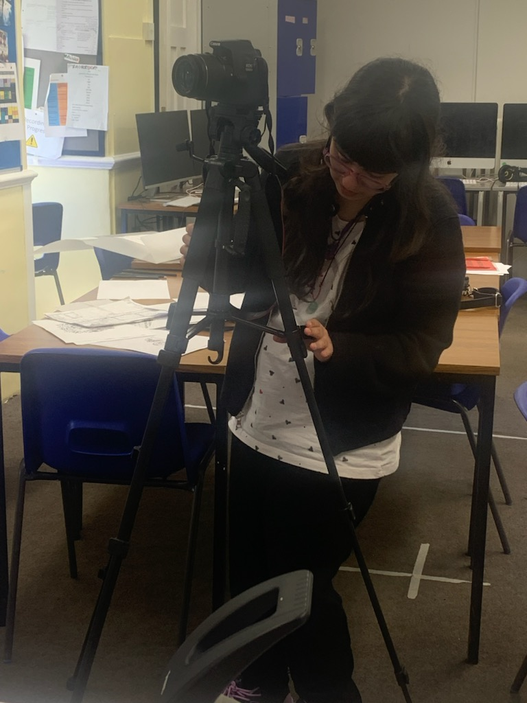
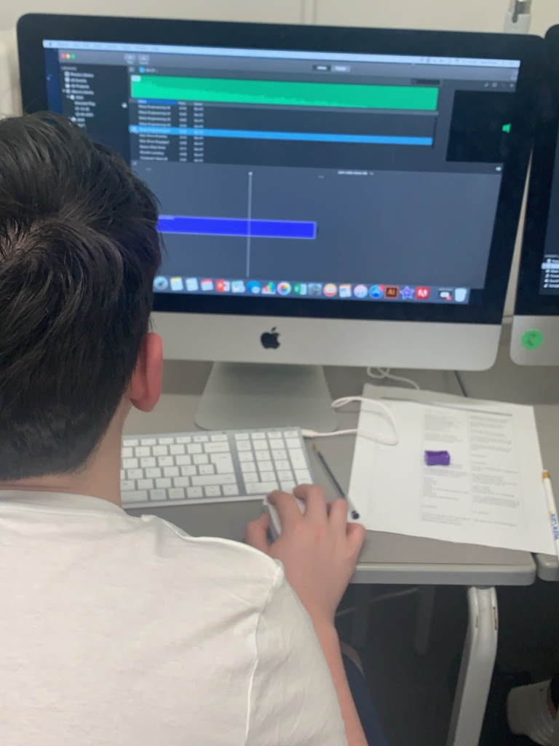
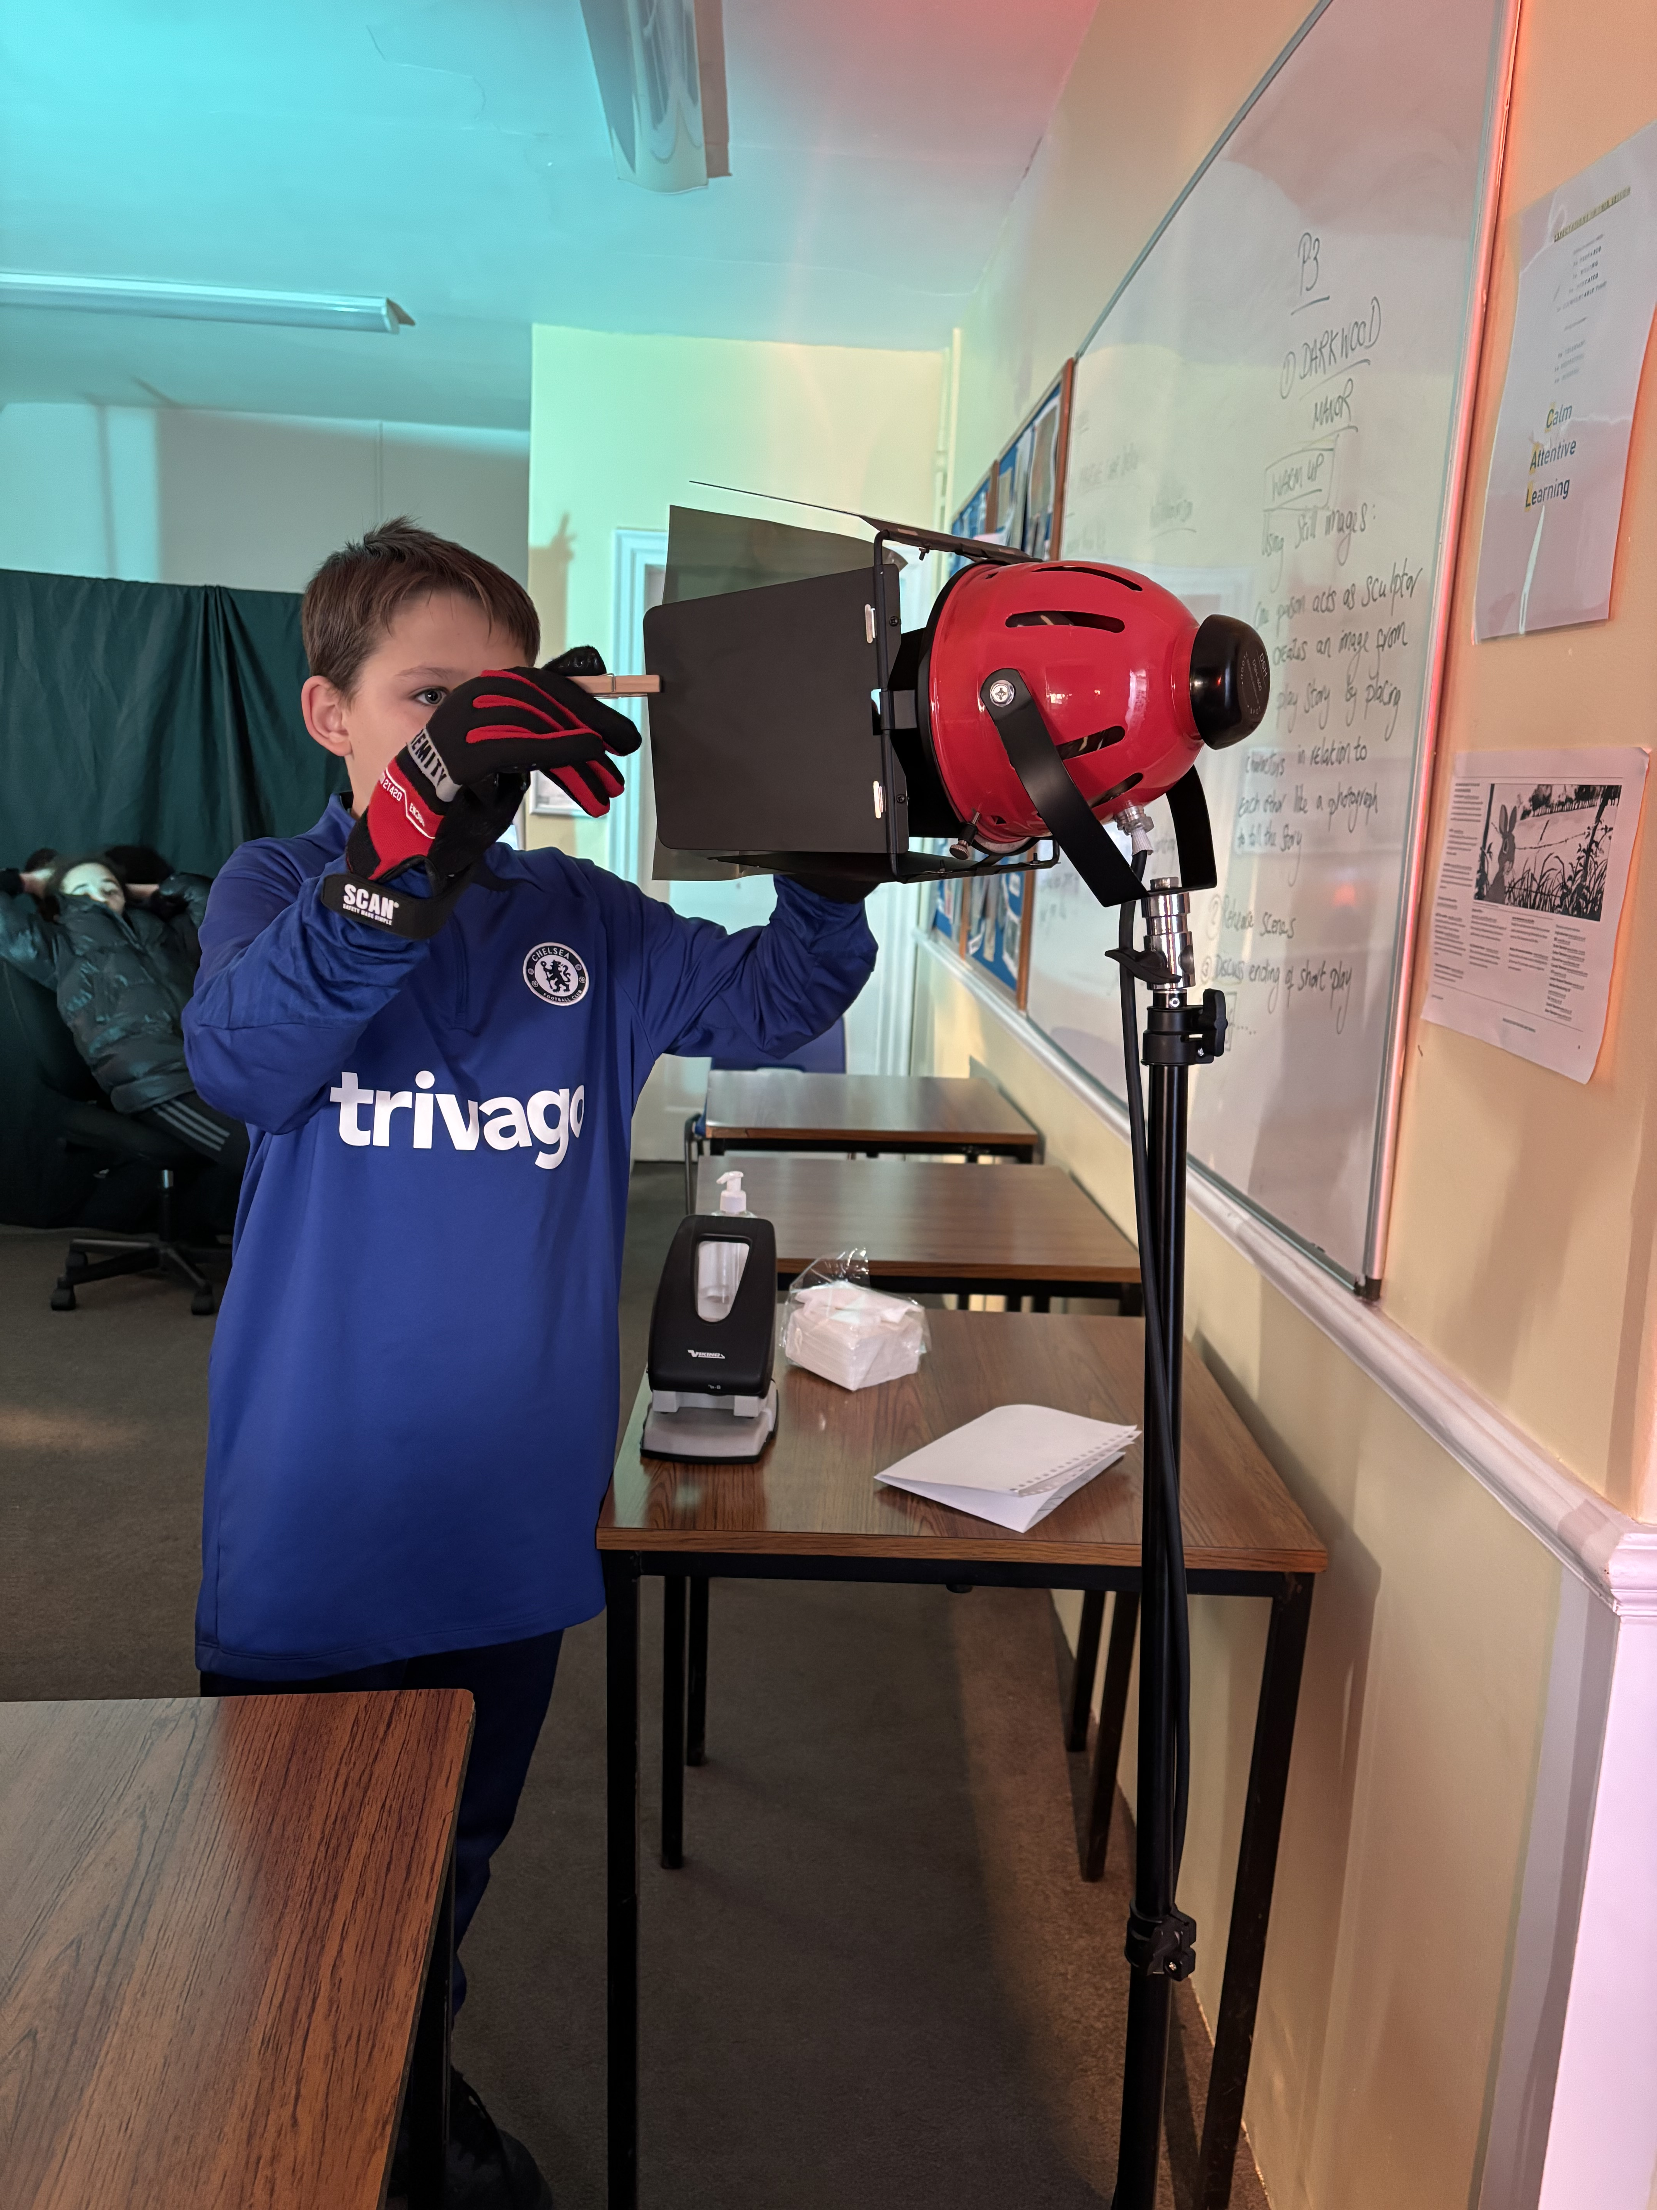
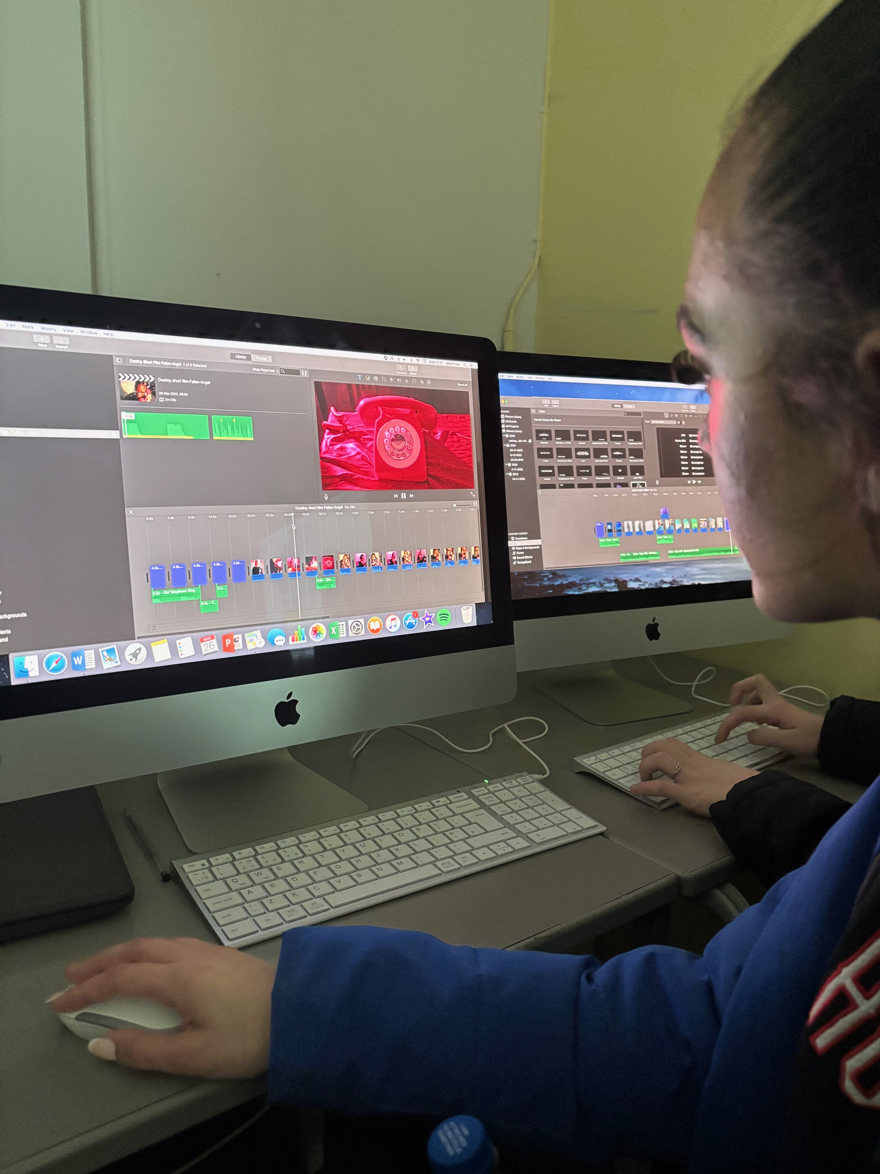
SUBJECT: film studies
Exam board: Eduqas
Qualification type: GCSE
Details of course: Film Studies consists of 2 written examinations.
Paper 1 Key Developments in US Cinema
Paper 2 Global Cinema.
Component 3: There is also a practical Non-Exam Assessment for which the students learn how to plan, write and produce a short film of 2.5 minutes.
The students also write and submit an essay discussing how they made their short film. The practical aspect of the course is ongoing throughout the 2 years study with the final complete film and film script submitted end of Spring term before the GCSE exams start in the Summer term.
Content covered: Studying film takes the students from being a member of the audience to being a film critic and film maker. We study the development of film making technology from early silent films through to the latest in digital film making. We learn about the technical elements of film such as costumes, set design, prop building, sound-track making, camera work, lighting and editing. Students study 6 films set by the exam board and they write about these films in the exams. These films reflect different important genres and eras of film making, for instance students can study and write about early silent cinema as well as contemporary independent film making, We also study films from different cultures and countries. Students learn advanced analytical thinking and writing skills and study how society and social contexts impact on cinema which is the most important art film of the modern age. For example: we study how the cold war is reflected in the rise of science fiction film making. We study how film makers can express important ideas about through making films. Students also visit film festivals and exhibitions and can take part in film making competitions.
Career/Further education Opportunities: Students can progress onto L3 courses in Film, Media, Journalism, Design. Script writing/creative writing. Previous students at CAL have gone onto the London Film School to study film directing and on to Goldsmith University to study Media and Journalism. Previous students have also progressed onto the L3 Extended Project Qualification where they researched in depth a subject of their choice such as animated film or voice-overs. There are a range of apprenticeships available in technical areas of film and media. The Film and Media industry in the UK is the largest in Europe with ITV, Channel 4, Sky being major players. Currently the students studying Creative Media skills courses have been following Media briefs set by Sky TV such as learning to make news reels and have the opportunity to submit their creative work for competitions run by Sky Studios. Media and Film employers have an emphasis on diverse employment practises and actively encourage neuro-diverse applicants. Film Studies also offers many transferable skills that are sought by colleges and employers such as research skills, analytical writing skills, critical thinking, technical skills such as being able to edit using a range of software and being able to make short digital film work.

Slide 18
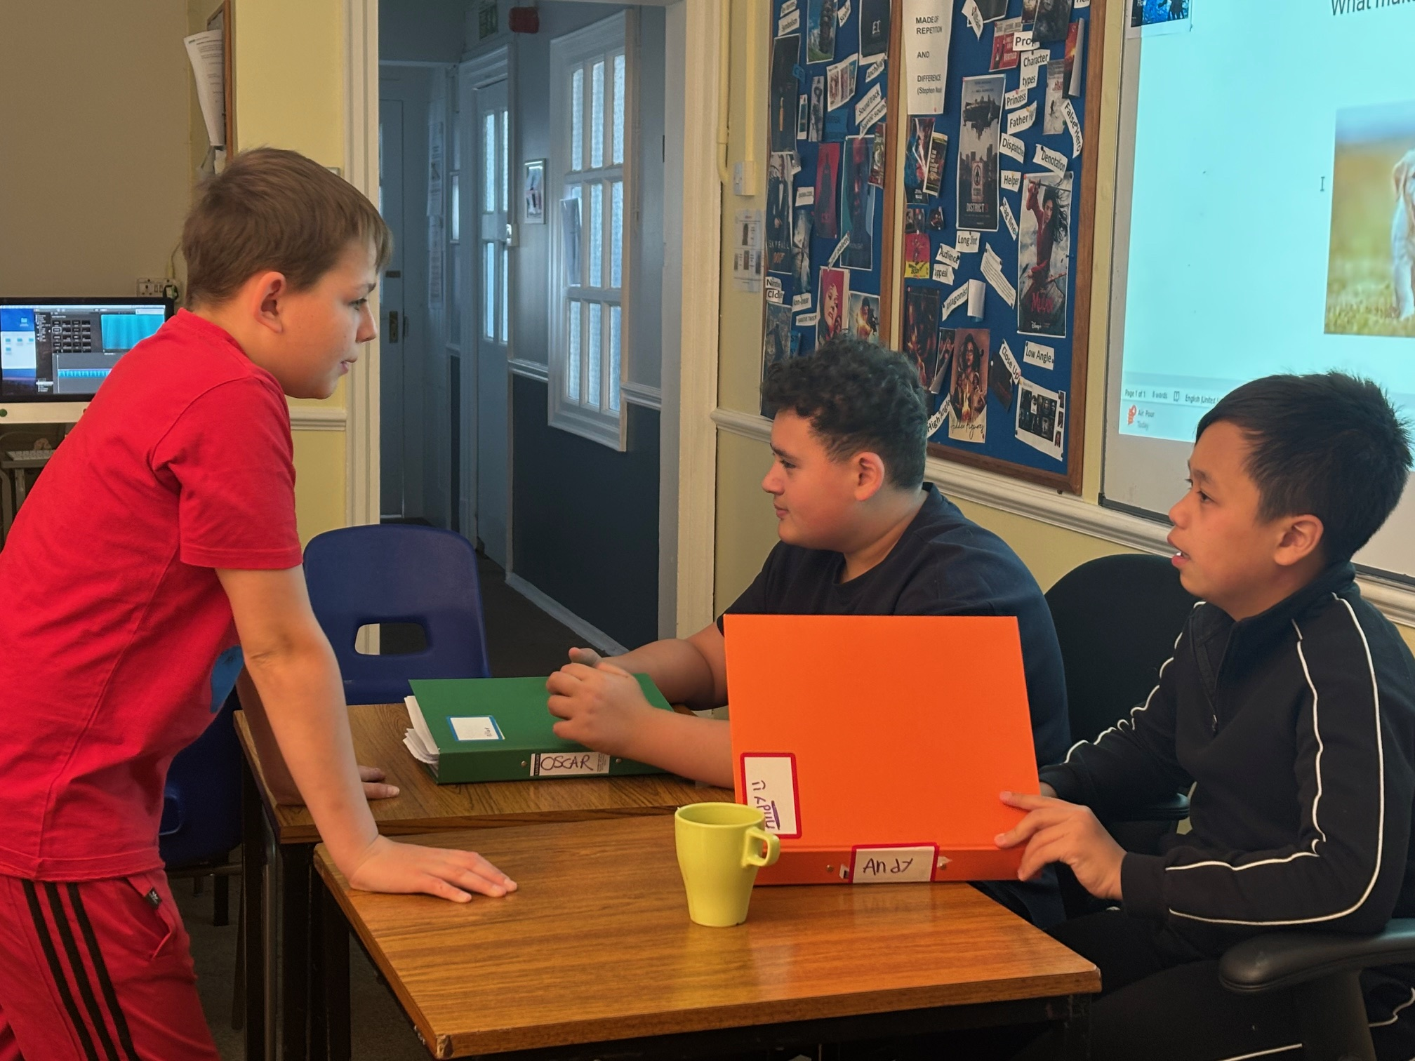
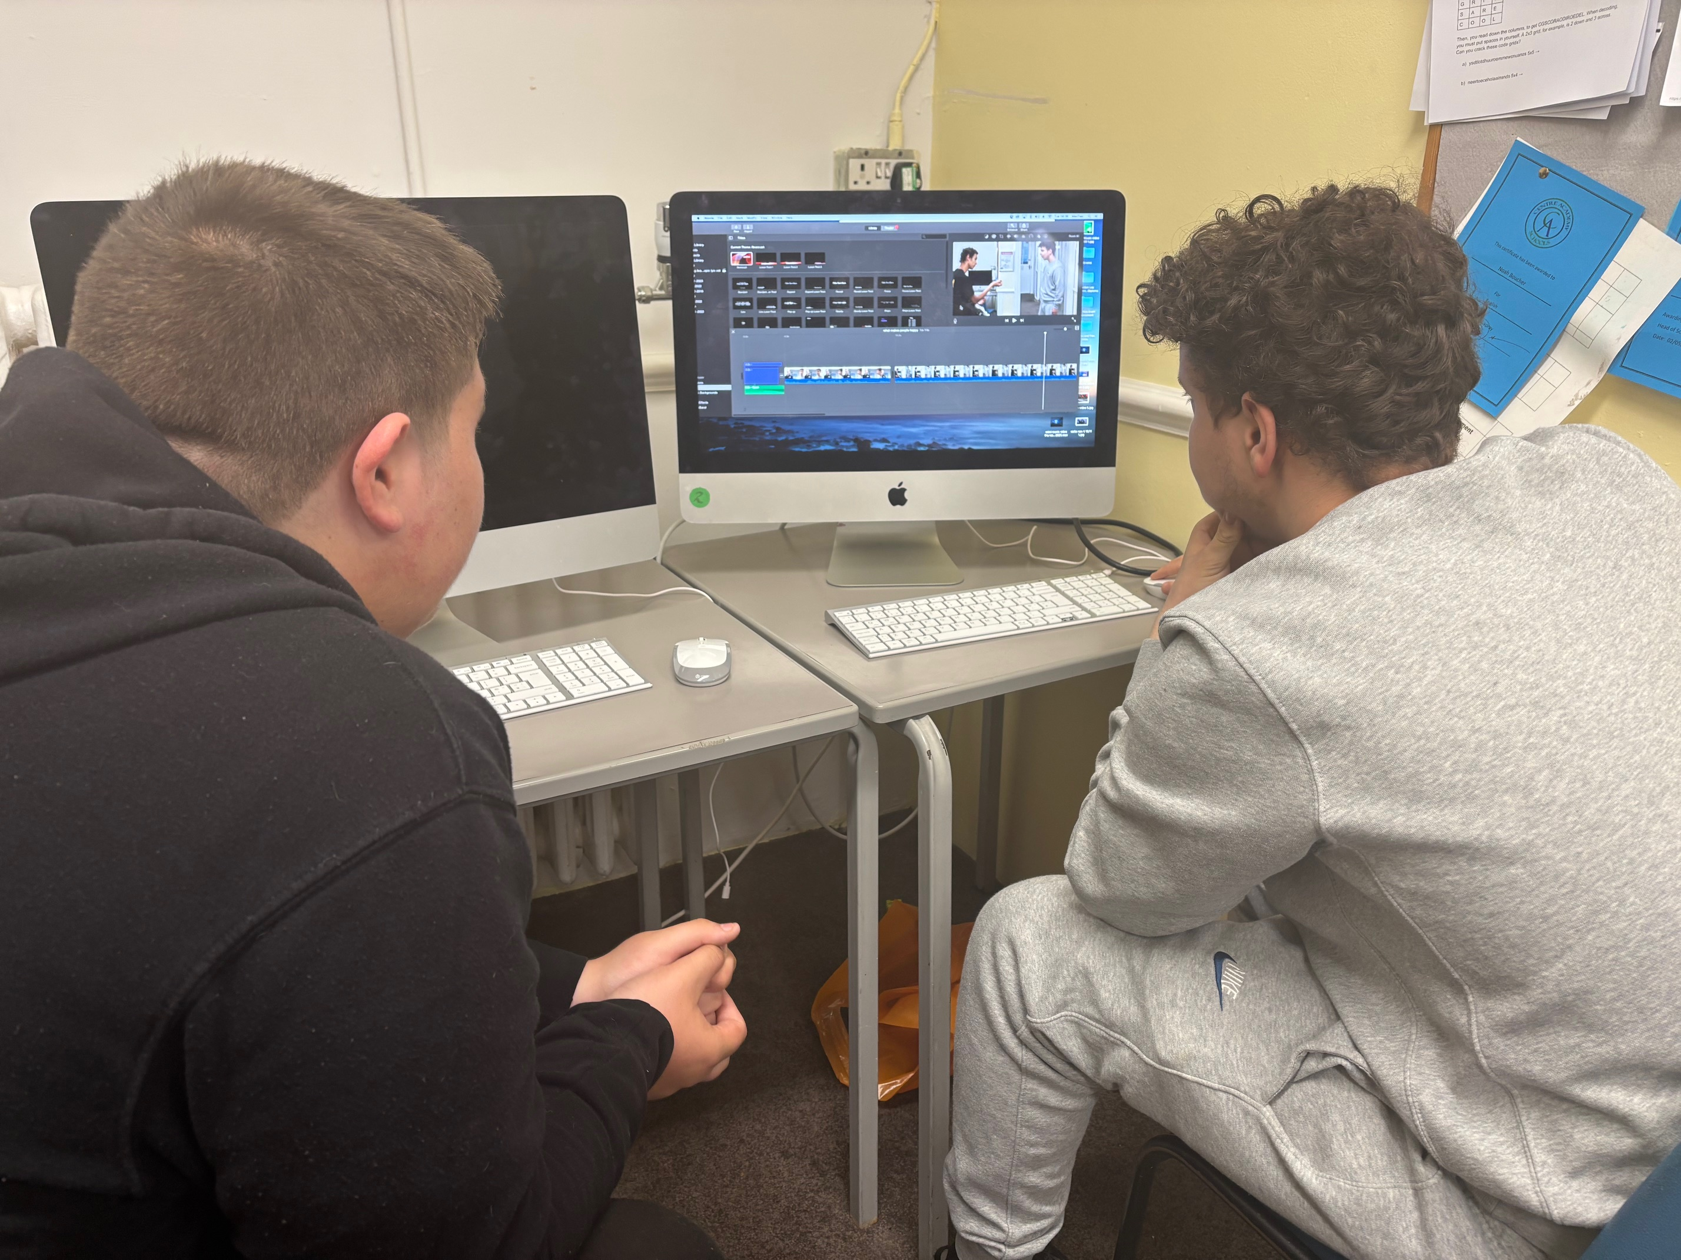
SUBJECT: FILM STUDIES
Studying film offers a unique blend of academic and highly creative work. It prepares students for work across various fields such as film production, media industries, marketing, advertising, journalism and education. Students rapidly improve their written skills through learning script writing and journalistic writing.
Film students learn valuable collaboration skills to produce short films and film-related projects and develop inter-personal skills and networking skills.

Slide 19
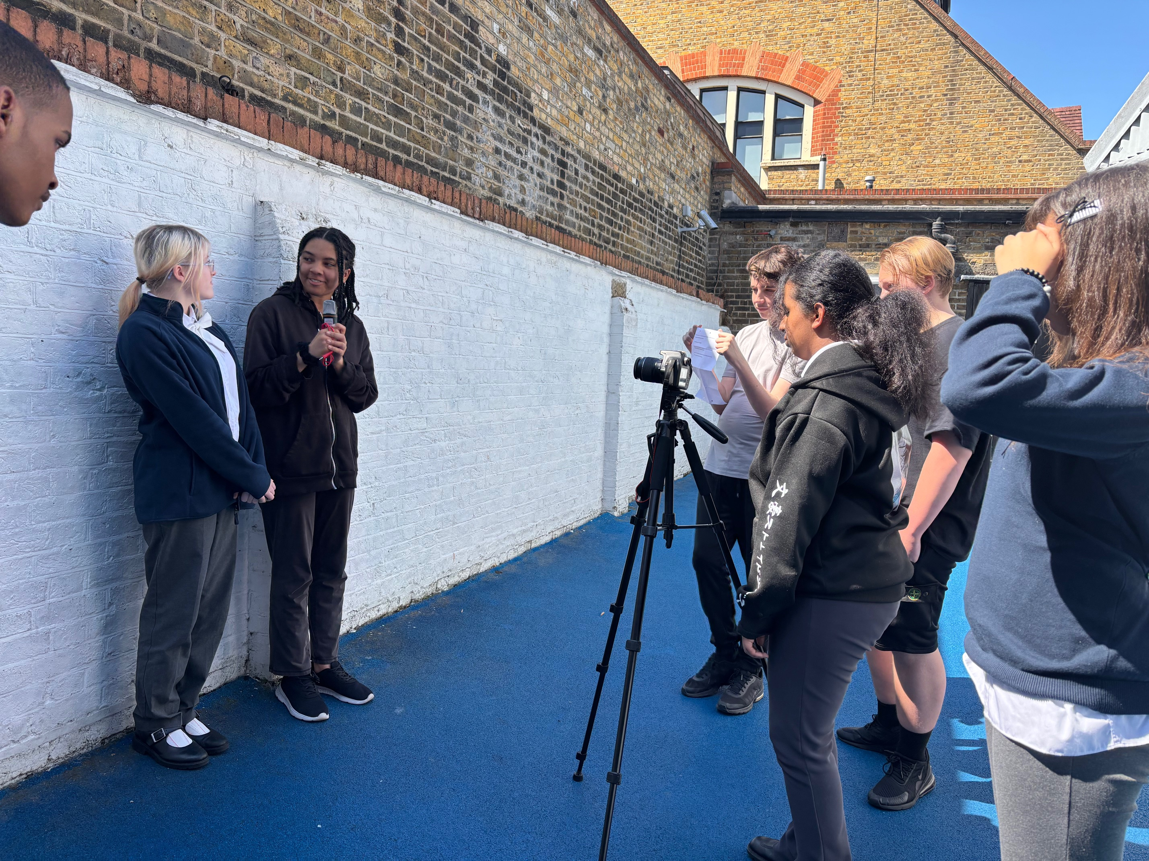
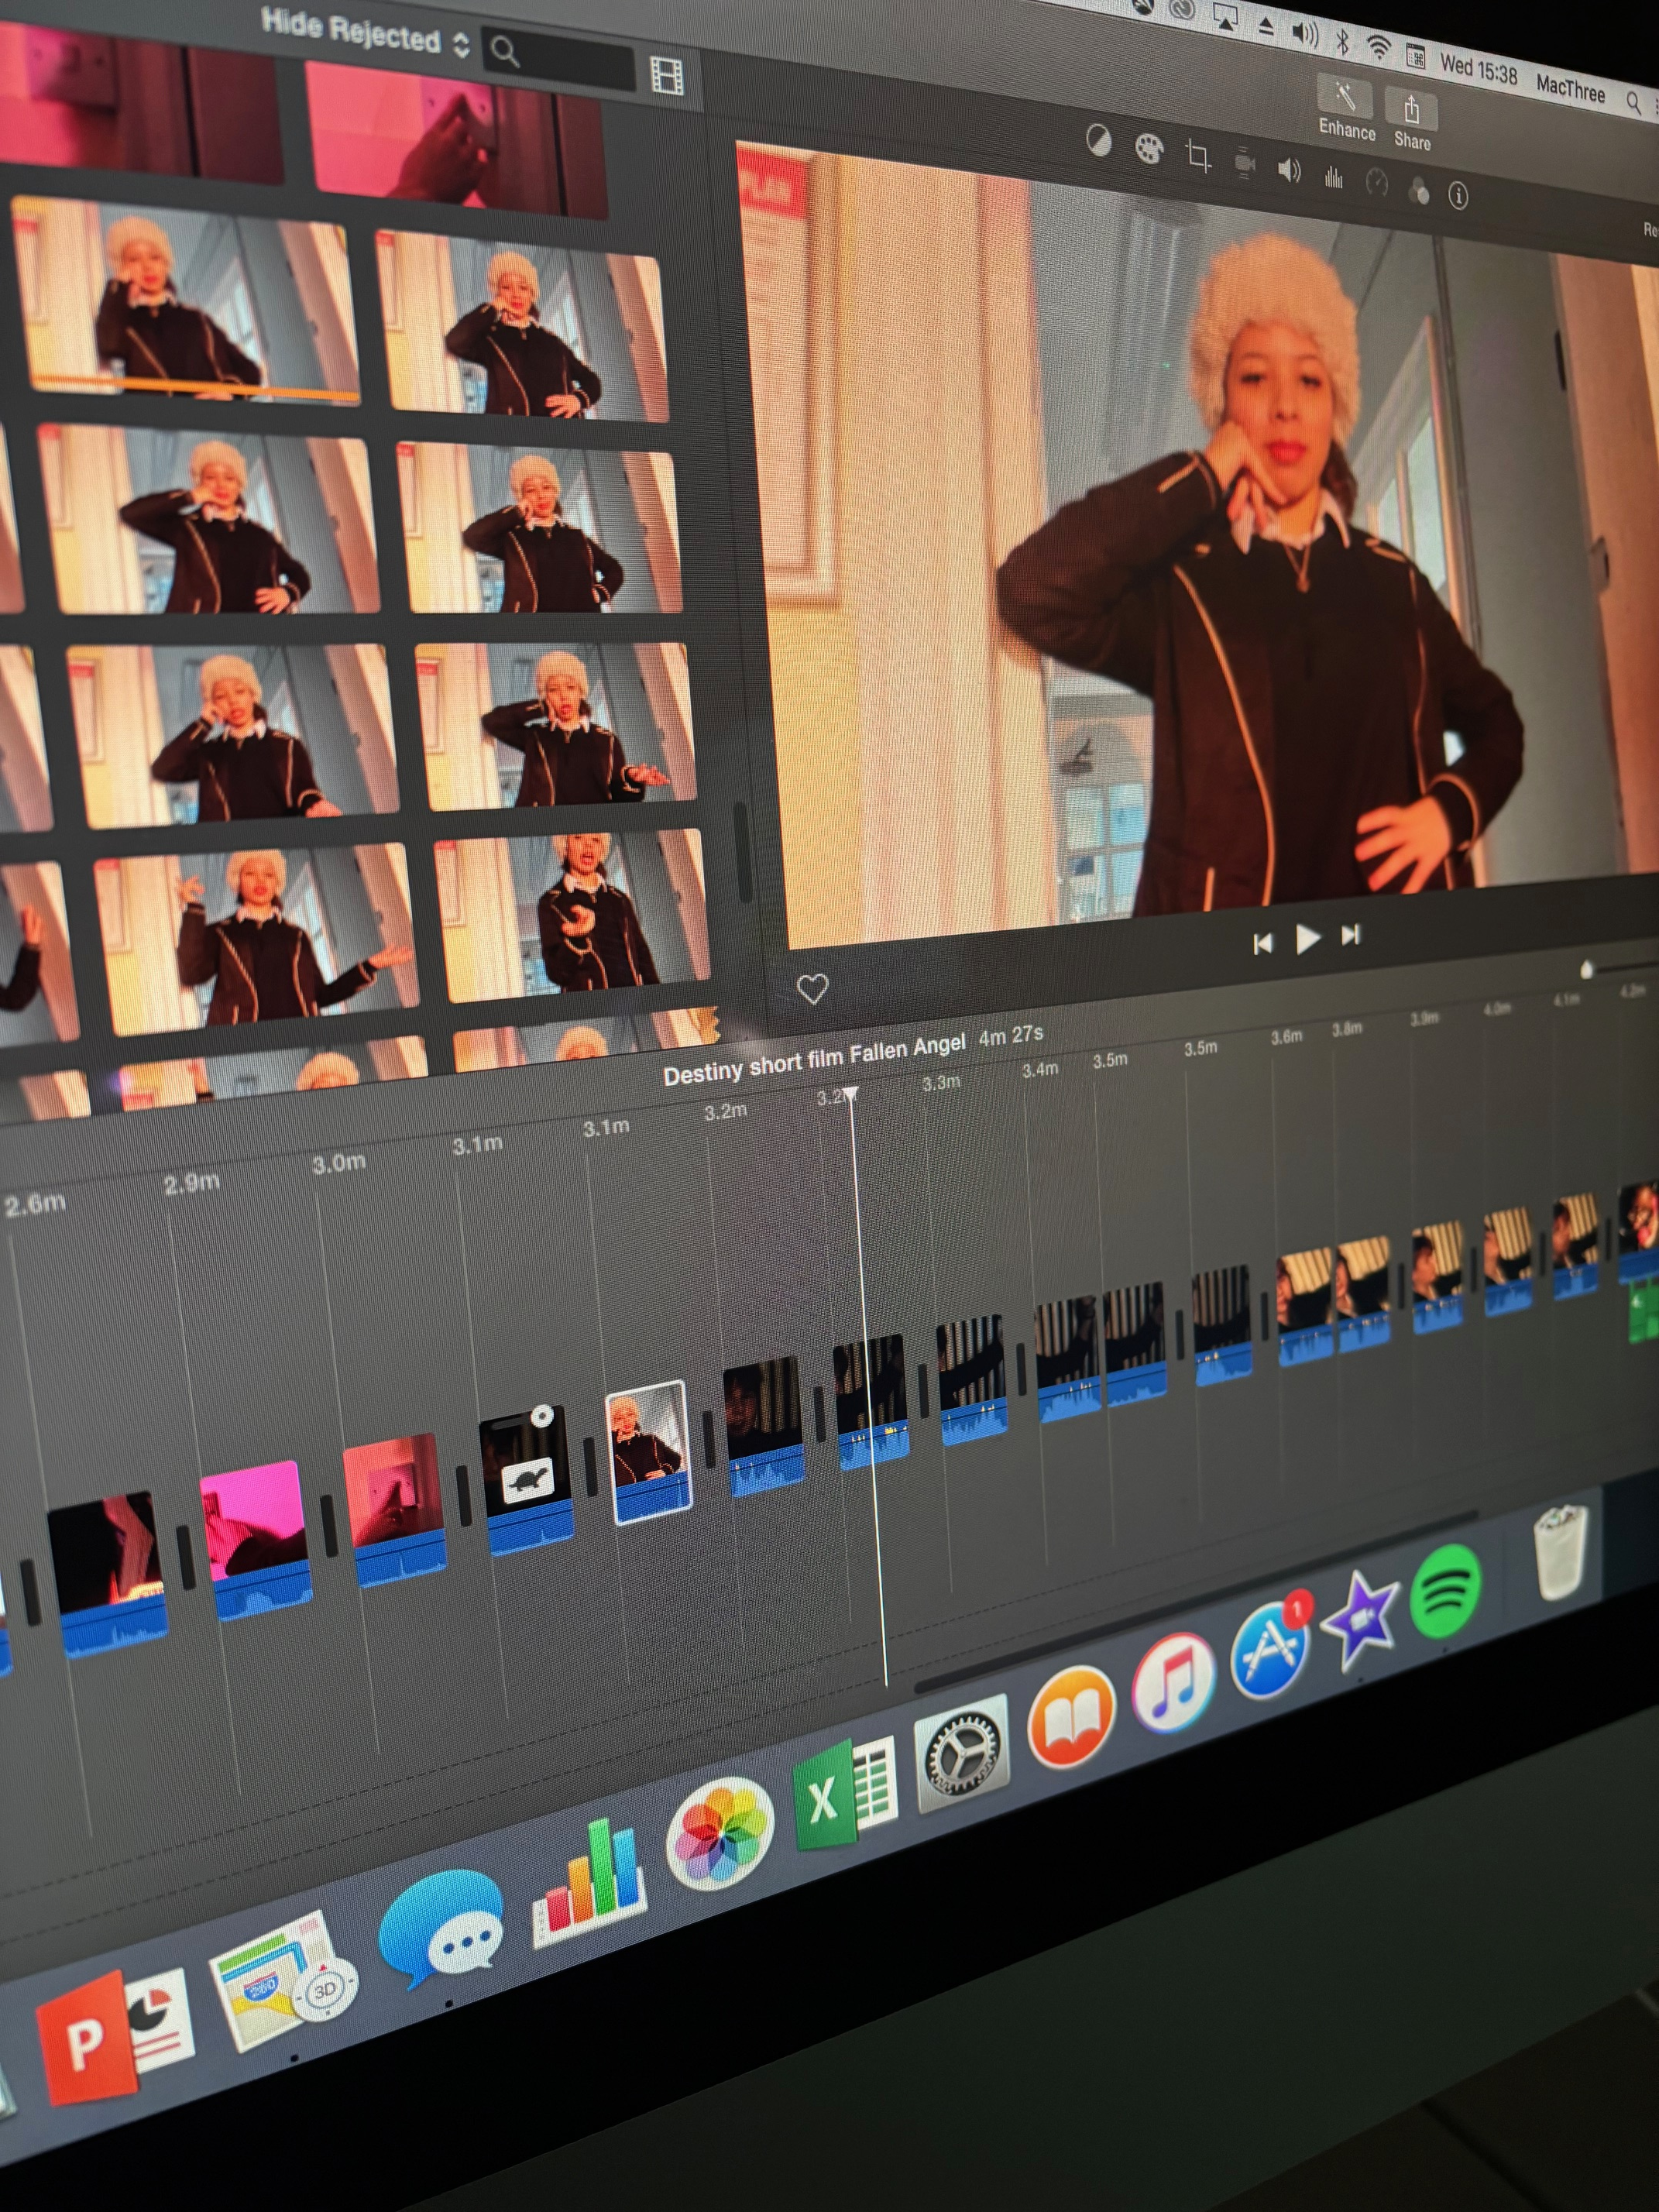
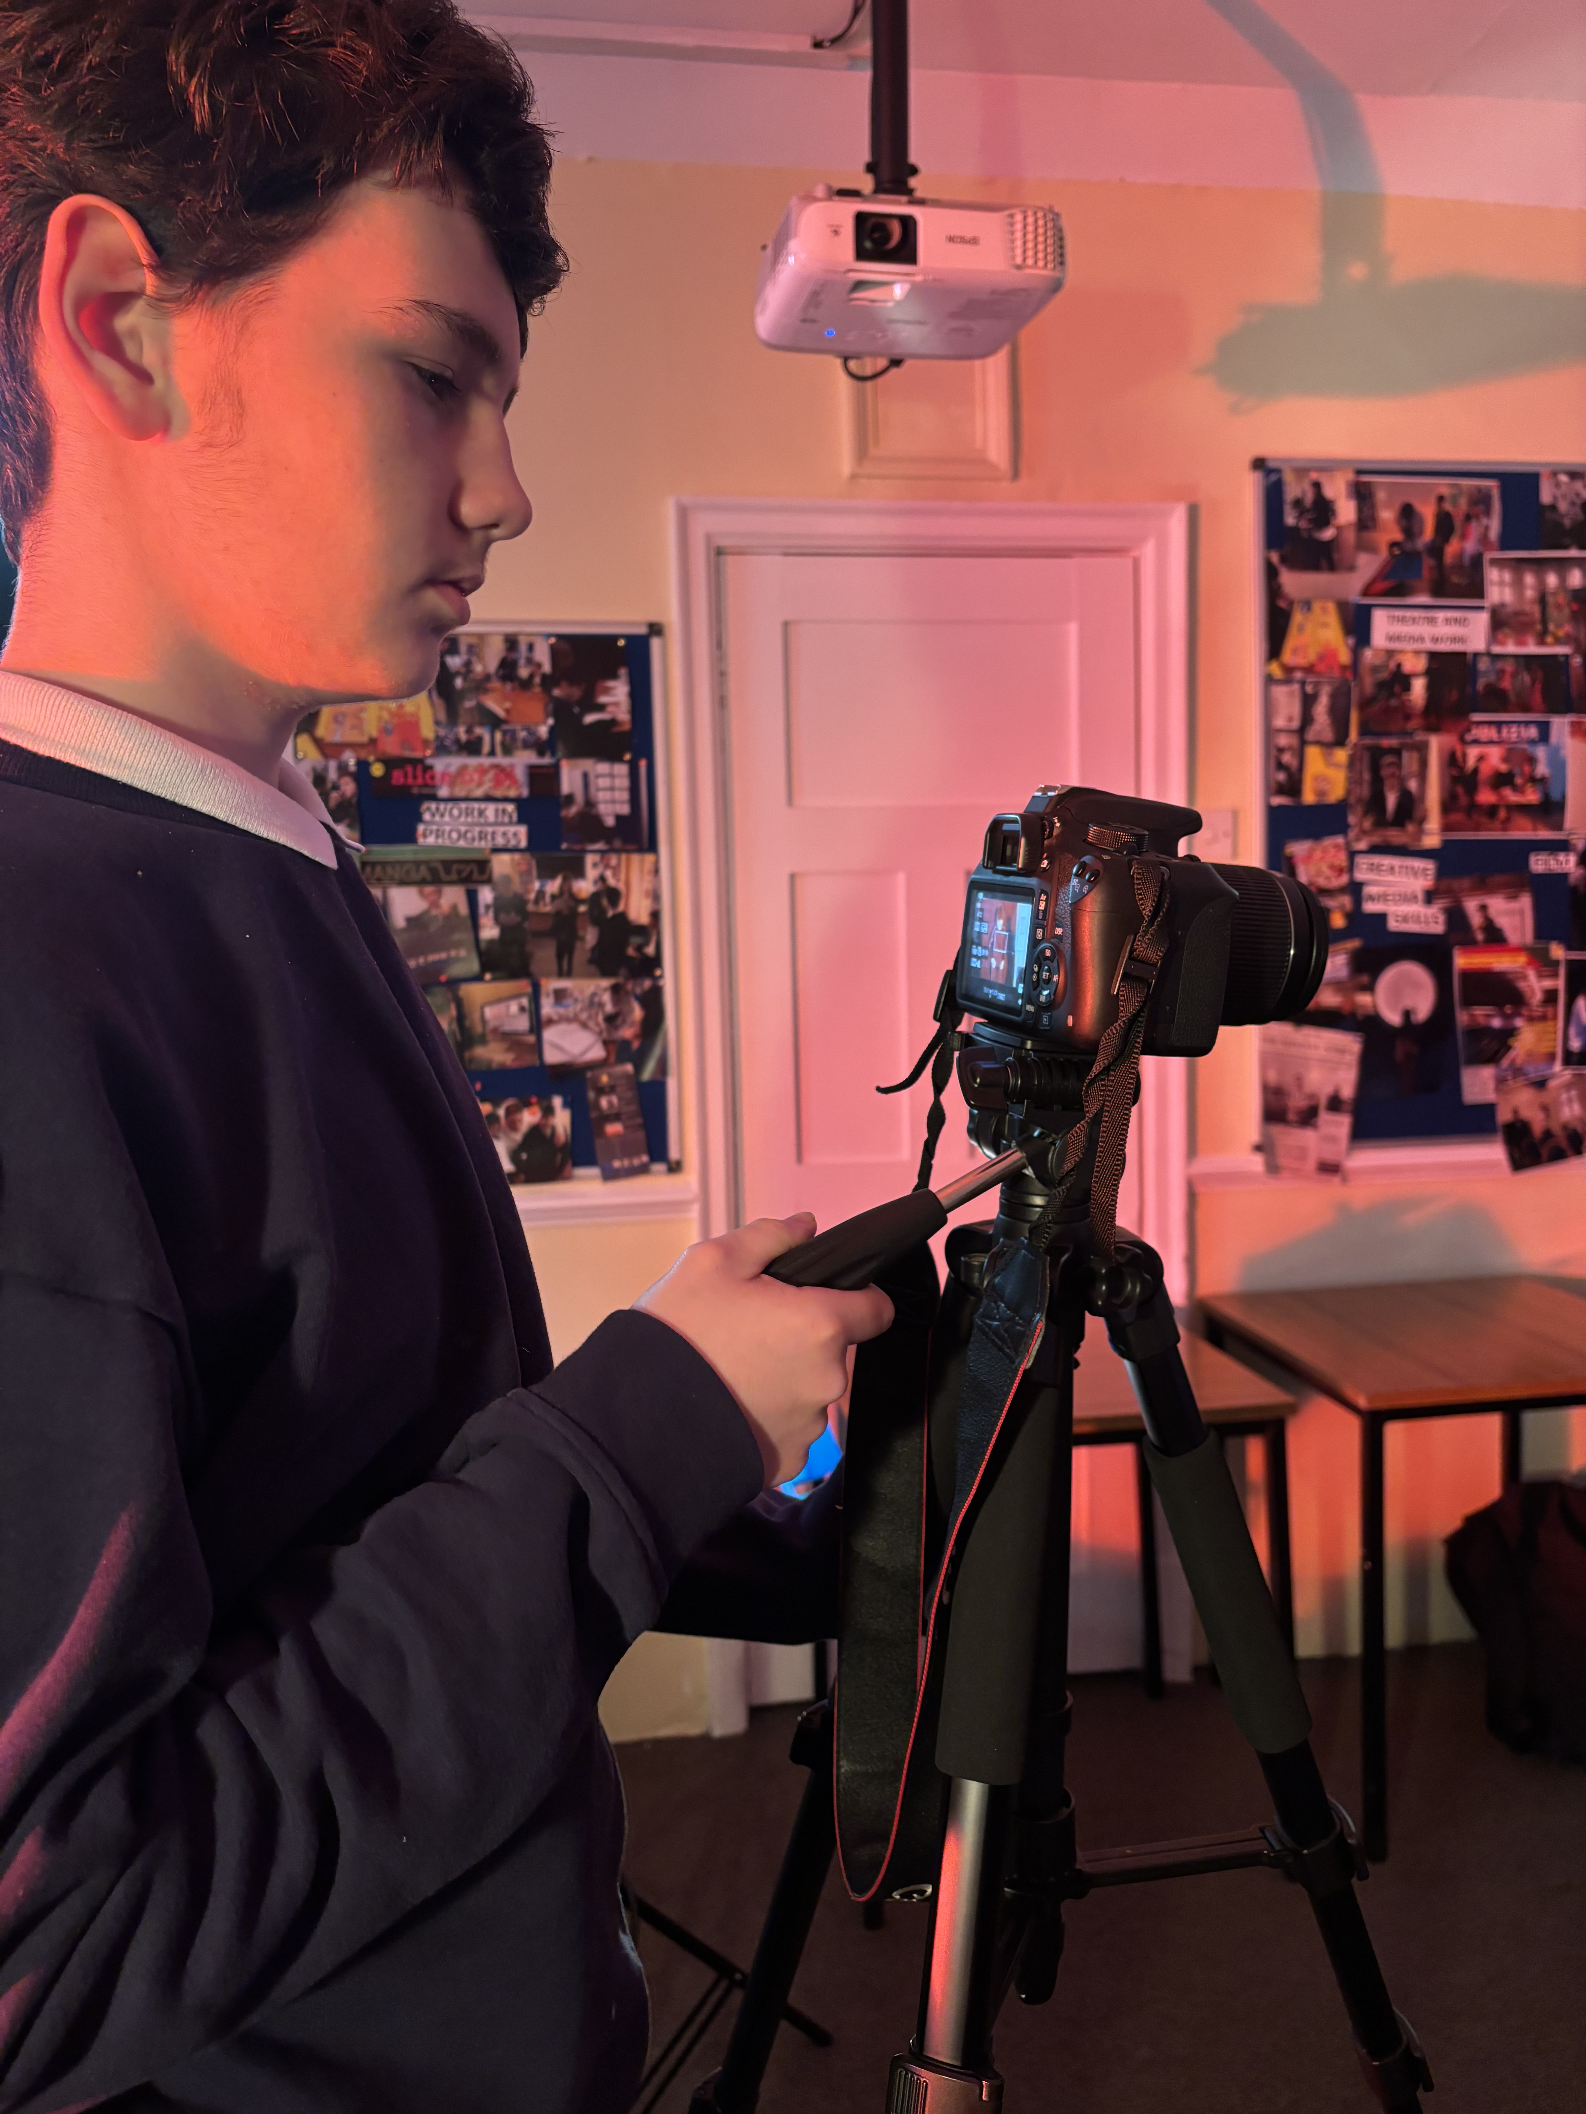
SUBJECT: FILM STUDIEs
Finally...student results:
Students have for the past three years done well in
Film Studies GCSE.
Students have achieved 100% pass rate between grades 4 – 8
Students enjoy the study of film because of the combination of academic rigour and creativity – they can produce unique personal film projects working individually or as a team.

Slide 20
SUBJECT: photography
Exam board: OCR
Qualification type: GCSE
Details of course:
Component 01 is the Portfolio. Learners must produce work in response to a centre- or learner-set brief or stimulus: a portfolio of practical work. This component is a non-exam assessment. It is internally assessed and externally moderated. This component is marked out of 120 marks and contributes 60% to the overall mark.
Component 02 is the externally set task. The paper is released 2nd January in the year of certification. It provides learners with five themes each with written and visual starting points or stimuli. From these, one option must be selected by the learner. Centres will allow learners a set period of time, at their discretion, to prepare for the Externally set task 10-hour supervised time period. The Externally set task is a non-exam assessment. It is internally assessed and externally moderated This component is marked out of 80 marks and contributes 40% to the overall mark.
Content covered: Photography is unique in its cross-curricular potential. On the technical side physics is important as students gain knowledge of how a camera controls light and how the input of light affects an image. On the critical side understanding aspects of English and history is important as students will study early photography and photography styles from the pin hole camera onwards. Underlying this, and most importantly, is creativity. To maximise engagement students choose their own practical themes so that they can explore and create a photographic portfolio on a topic they enjoy such as nature, music, street photography, fashion, dance and more. By the end of the course the students are expected to have taken a wide range of photographs. They are expected to be able to evaluate the work of other photographers.
Career/Further education Opportunities: Photography is proving to be one of the most popular courses post 16. Having engaged in a course that is mindful and progressively engaged with the vocational aspects of photography gives a head start in a competitive industry. Post 16 courses give opportunities to refine your skills and enhance prior learning with a smooth progression onto diploma courses and even BA Honour degrees.
Potential careers include merchandise photographer, working on websites, fashion photographer, portrait photographer, wedding photography, TV and Film photographer, promotions, advertising, documentary, film making, cinematography and photojournalism.

Slide 21
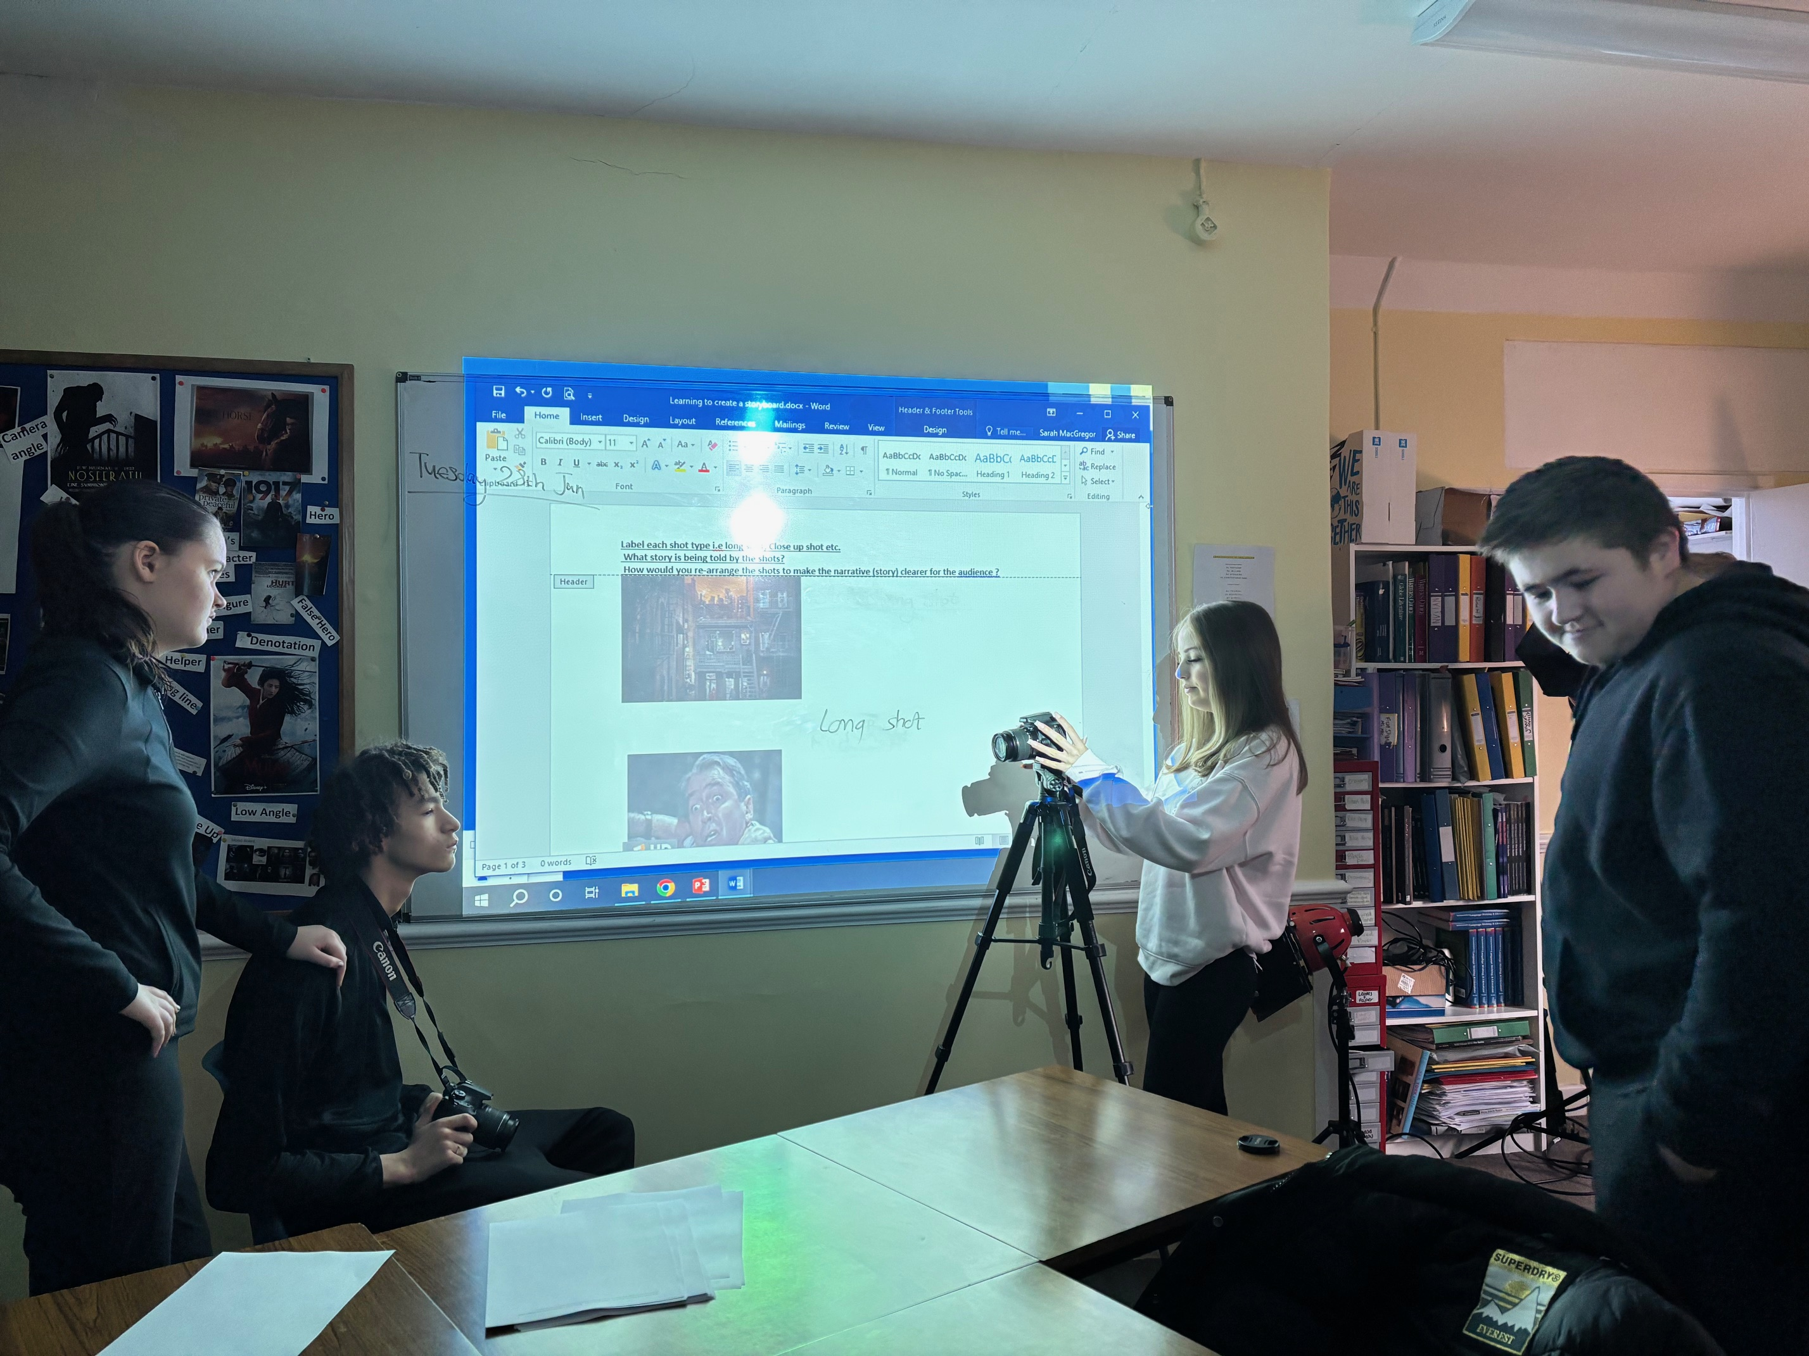
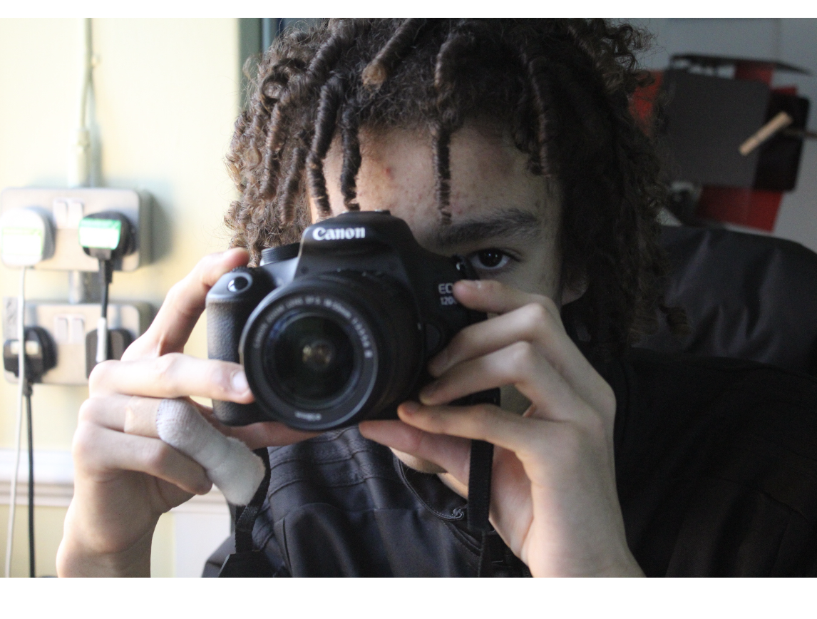
SUBJECT: photography
Why pick Photography GCSE? Most of the students have already started studying photography as part of their BTEC Courses in Creative Media Skills. Many of the students have said they really enjoyed the creative, technical and social aspects of photography and many of them have already gained high grades with photography skills for their Assignment 1 of Creative Media.
For instance 3 of the current Media students gained Distinctions from the external examining board for producing and designing photographic magazine covers. An additional 5 students achieved Merits for their photographic magazine covers. Here are some of the students' magazine designs and photographic work. Several of the students have already progressed onto creating photography portfolios, with one of our cohort already gaining a Double Distinction for both magazine photography and a photographic portfolio.

Slide 23
Name of Pupil: ____________________________________
Option Choices ranked 1-5: (1=1st choice/priority...5th is last choice/priority)
Option subjects: History, Art, Film studies, IT, BTEC Sport, Photography)
1:_______________________________________________
2:_______________________________________________
3:_______________________________________________
4:_______________________________________________
5:_______________________________________________
Student signature: ________________________________
Parent approval signature: _________________________
*We will do our best to place students in their first choices, but this will depend on demand, cohort, ability, and staffing.
Name of Pupil: ____________________________________
Option Choices ranked 1-5: (1=1st choice/priority...5th is last choice/priority)
Option subjects: History, Art, Film studies, IT, BTEC Sport, Photography)
1:_______________________________________________
2:_______________________________________________
3:_______________________________________________
4:_______________________________________________
5:_______________________________________________
Student signature: ________________________________
Parent approval signature: _________________________
*We will do our best to place students in their first choices, but this will depend on demand, cohort, ability, and staffing.

